Slide 1
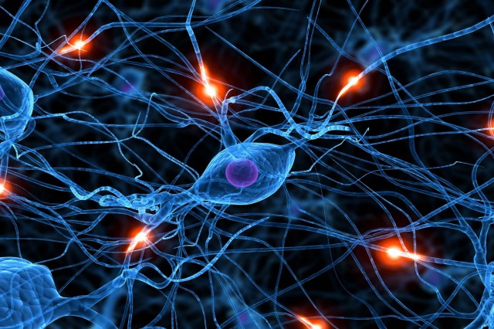
Black Box Methods – NNs and SVNs Lantz Ch 7
Right - What Neural Nets are modeled on – the human brain. And, they are growing in usage, because NN’s run fast and can do difficult tasks like image recognition.
Wk 4, Part 1
Notes:
Image from http://www.extremetech.com/computing/167179-facebook-is-working-on-deep-learning-neural-networks-to-learn-even-more-about-your-personal-life

Slide 2
Do artificial NN’s model the brain?
Kind of –
We are still learning about the brain, so
This is a moving target for AI.
Copied are –
The idea of massively parallel functions, and
The interconnections between nodes.
Main use – Using training to learn some general discrimination skill.

Slide 3
NN’s are irrational
They do something internally when they learn.
It’s not a set of intelligible rules.
But it works.
NN’s are partly a reaction to the logical style of AI, which insists on building systems we CAN analyze internally.
NN’s also run really fast, especially when run on special, truly parallel hardware.

Slide 4
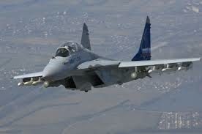
Really 2 kinds of NN’s
Special hardware –
High degree of parallelism.
Once trained, they run super fast.
Suitable for real-time tasks.
Emulated –
Not so fast.
Still can get NN results.
Hmm… Is that an F-15, or a MIG-35 on my tail?
Notes:
Image from http://www.1zoom.net/Aviation/Mikoyan_MiG-35/t2/1/.

Slide 5
At the heart of AI
This is the other side of machine learning from decision trees:
Those were cool because they discovered general principles we could understand.
NN’s are cool because how they work is only visible in principle, not exactly how they function once they are trained.
Very close to “magic sponsored by science.”
Notes:
Image from http://natureofcode.com/book/chapter-10-neural-networks/

Slide 6
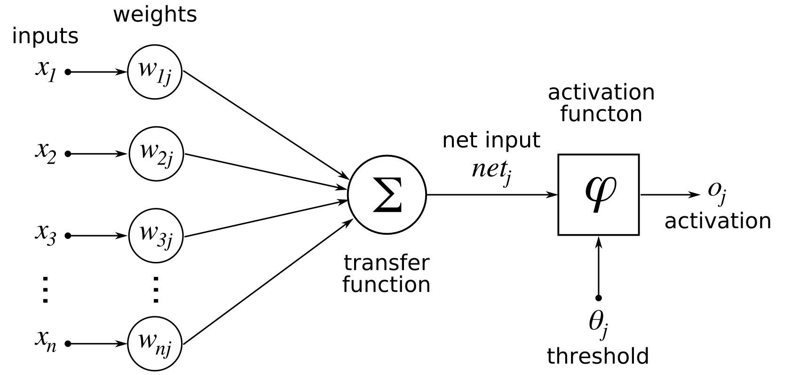
Activation function
Notes:
Image from http://en.wikibooks.org/wiki/Artificial_Neural_Networks/Activation_Functions

Slide 7
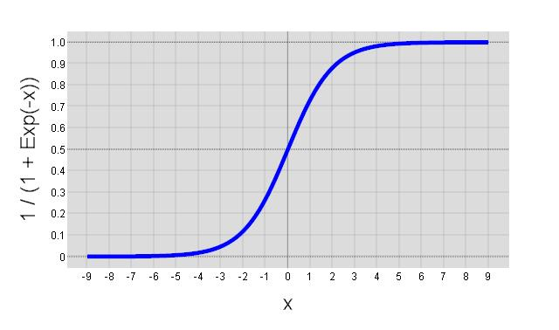
Commonly used for activation
Notes:
Image from http://colinfahey.com/neural_network_with_back_propagation_learning/neural_network_with_back_propagation_learning.html

Slide 8
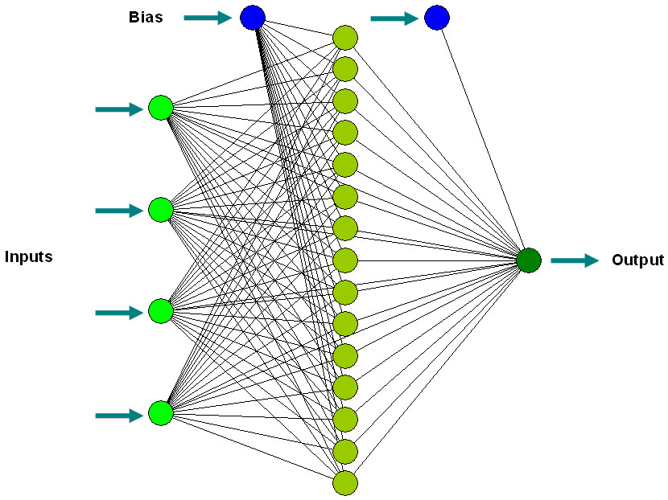
Acts on a network topology
Notes:
Image from http://www.biomedcentral.com/1472-6750/7/53/figure/F2?highres=y

Slide 9
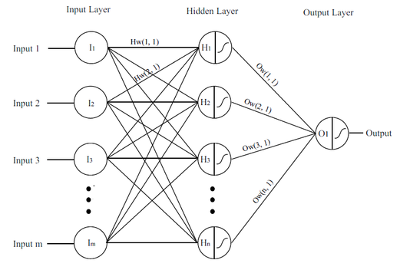
Common to have hidden nodes
Notes:
Image from http://igva2012.wikispaces.asu.edu/aarvay+-+Paper+3+-+Data+driven+visualization+of+neural+networks

Slide 10
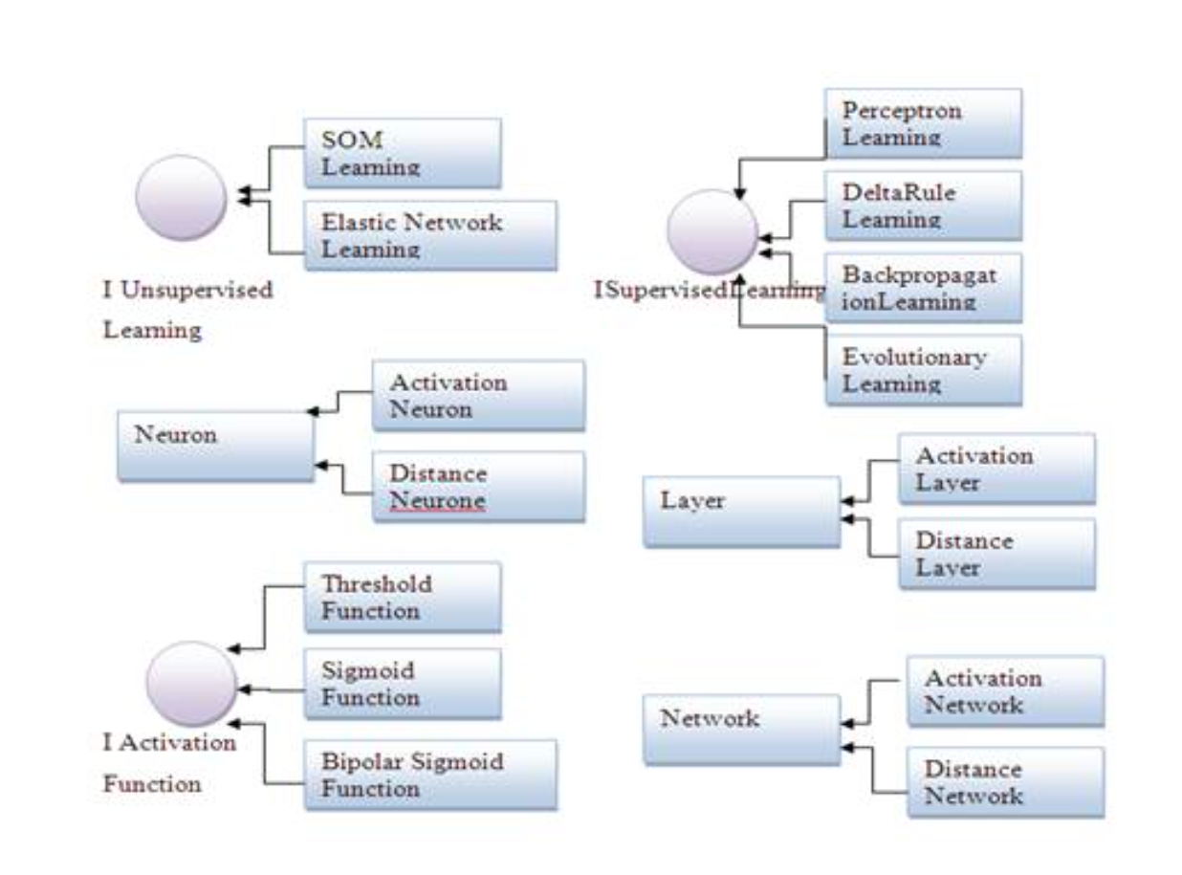
…Using some learning algorithm
Notes:
Image from http://www.itengineerings.com/aforge-net-framework-artificial-neural-networks-development/

Slide 11
Back propagation is popular
Strengths | Weaknesses
Can be adapted to classification or numeric prediction problems. | Reputation of being computationally intensive and slow to train, particularly if the network topology is complex.
Among the most accurate modeling approaches. | Easy to overfit or underfit training data.
Makes few assumptions about the data’s underlying relationships. | Results in a complex black box model that is difficult if not impossible to interpret.

Slide 12
Once it’s trained
We use it in production mode, to give those magical answers.
It doesn’t change how it operates, just gives answers.

Slide 13
Lantz’s “concrete” example
> concrete <- read.csv("/Users/chenowet/Documents/Rstuff/concrete.csv")
> str(concrete)
'data.frame': 1030 obs. of 9 variables:
$ cement : num 141 169 250 266 155 ...
$ slag : num 212 42.2 0 114 183.4 ...
$ ash : num 0 124.3 95.7 0 0 ...
$ water : num 204 158 187 228 193 ...
$ superplastic: num 0 10.8 5.5 0 9.1 0 0 6.4 0 9 ...
$ coarseagg : num 972 1081 957 932 1047 ...
$ fineagg : num 748 796 861 670 697 ...
$ age : int 28 14 28 28 28 90 7 56 28 28 ...
$ strength : num 29.9 23.5 29.2 45.9 18.3 ...

Slide 14
Data is “normalized”
Like we did for Nearest Neighbor in Ch 3:
> normalize <- function(x) {
+ return((x-min(x)) / (max(x)-min(x)))
+ }
> concrete_norm <- as.data.frame(lapply(concrete, normalize))
> summary(concrete_norm$strength)
Min. 1st Qu. Median Mean 3rd Qu. Max.
0.0000 0.2664 0.4001 0.4172 0.5457 1.0000

Slide 15
Training the NN model
> concrete_model <- neuralnet(strength ~ cement + slag + ash + water + superplastic + coarseagg + fineagg + age, data = concrete_train)
> plot(concrete_model)
> model_results <- compute(concrete_model, concrete_test[1:8])
> predicted_strength <- model_results$net.result
> cor(predicted_strength, concrete_test$strength)[,1]
[1] 0.805273935
→ Next slide

Slide 16
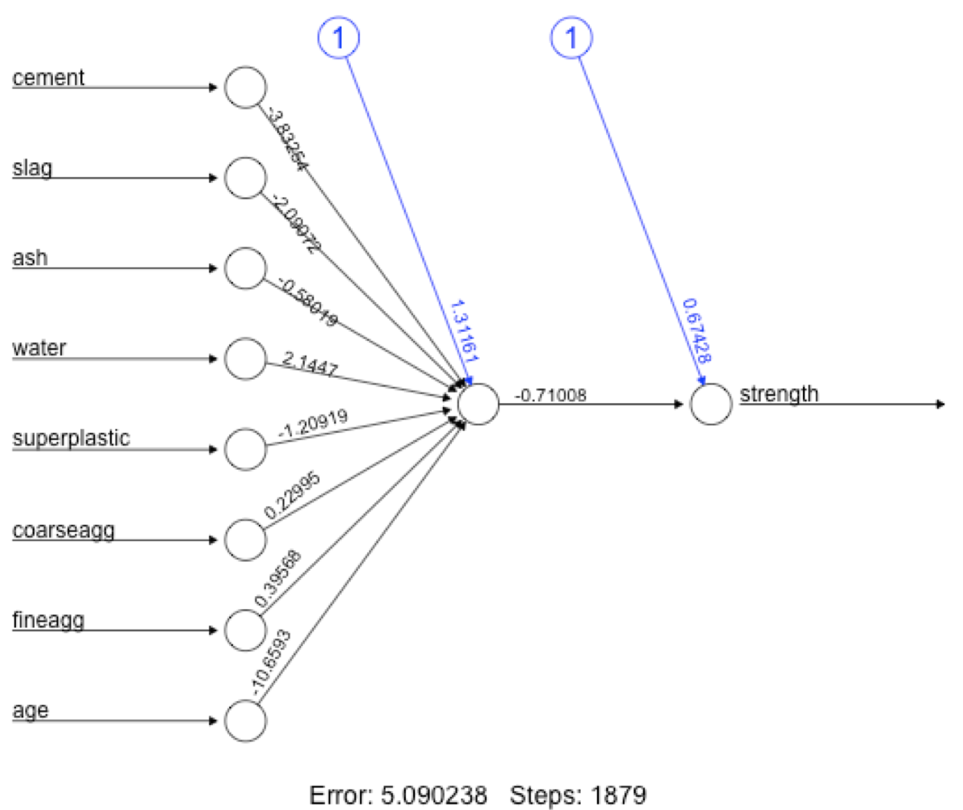
Training results

Slide 17
Improving NN model performance
> concrete_model2 <- neuralnet(strength ~ cement + slag + ash + water + superplastic + coarseagg + fineagg + age, data = concrete_train, hidden = 5)
> plot(concrete_model2)
Warning message:
In (function () : Only one RStudio graphics device is permitted
> model_results2 <- compute(concrete_model2, concrete_test[1:8])
> predicted_strength2 <- model_results2$net.result
> cor(predicted_strength2, concrete_test$strength)[,1]
[1] 0.9317343591
→ Next slide

Slide 18
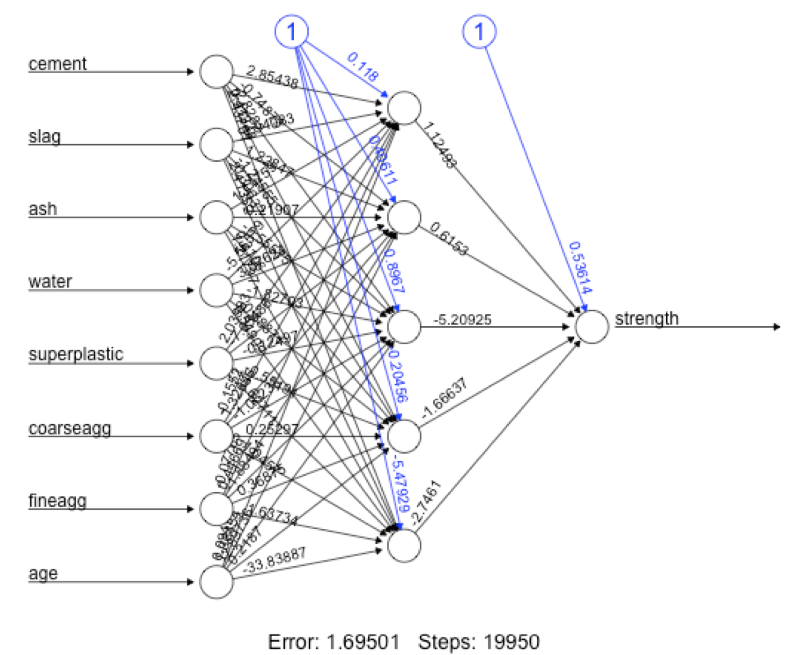
The new topology

Slide 19
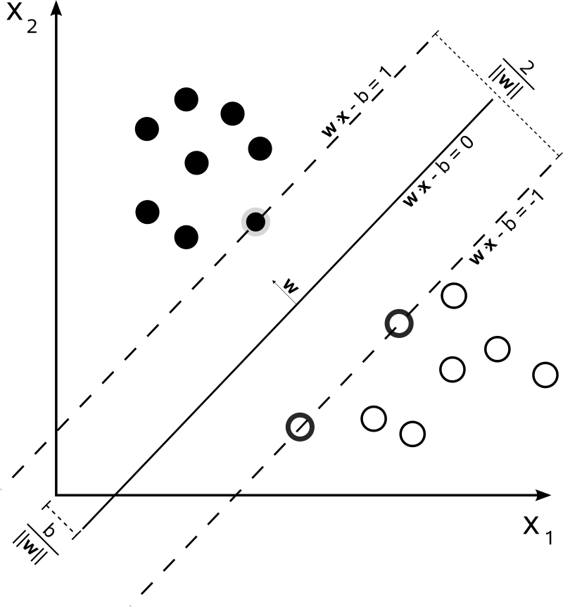
Support Vector Machines?
Goal is to find a hyperplane separating, categorizing, or grouping the data.
Idea is to find the plane making the “gap” as wide as possible.
Like a combination of “Nearest Neighbor” and Regression.
Notes:
Image from http://en.wikipedia.org/wiki/Support_vector_machine

Slide 20
Goal -- separate “convex hulls”
It’s like, “How big a mattress can you get up a stairway?”
Notes:
Image from http://www.slideshare.net/mohankumaryadav/microarray-16430408

Slide 21
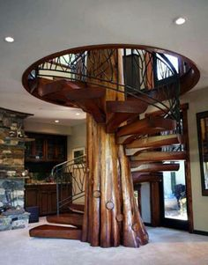
And the stairway could look like this:
Notes:
Image from https://www.pinterest.com/michaelcross393/stuff-i-love/.

Slide 22
Mathematically
We want to separate the points with some property from the ones without it, in a way that can be computed easily.
Start with some training data D, a set of n points of the form:
Vectors with p features
In or out of the class
Notes:
Description from http://en.wikipedia.org/wiki/Support_vector_machine.

Slide 23
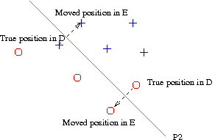
Adding costs
If no hyperplane works, we can optimize what we have by adding costs, in training, for being wrong.
This effectively “moves” the wrong examples in influencing where the best line is.
Notes:
Image from http://www.cs.nyu.edu/faculty/davise/ai/linearSeparator.html.

Slide 24
Let’s look at a different view of SVM’s
From http://www.cs.columbia.edu/~kathy/cs4701/documents/jason_svm_tutorial.pdf.
By Jason Weston, NEC Labs America.
Typical decent presentation of an abstruse math topic!
See also Moodle for this reference, and more.
Lantz’s Ch8 section is a pretty good intro.

Slide 25
The non-linear case
Use higher-dimensional spaces to make the separation of categories appear linear.
This is ‘the kernel trick”:
Strengths | Weaknesses
Can be used for classification or numeric prediction problems. | Finding the best model requires testing of various combinations of kernels and model parameters.
Not overly influenced by noisy data and not very prone to overfitting. | Can be slow to train, particularly if the input dataset has a large number of features or examples.
May be easier to use than neural networks, particularly due to the existence of several well-supported SVM algorithms. | Results in a complex black box model that is difficult if not impossible to interpret.
Gaining popularity due to its high accuracy and high-profile wins in data mining competitions.

Slide 26
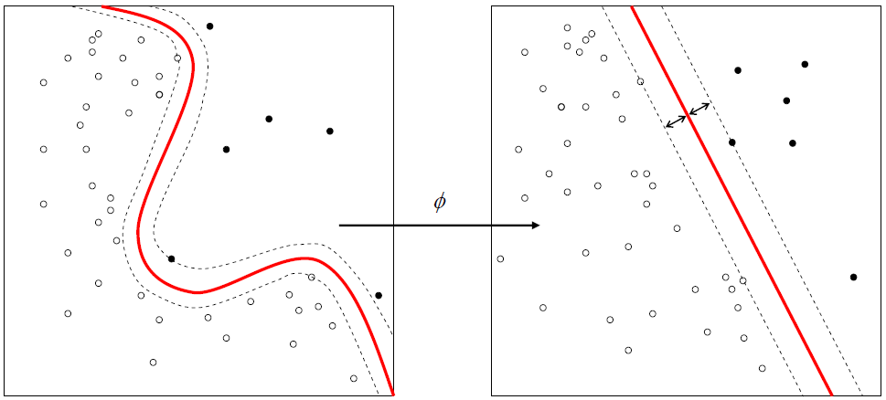
Goal of using nonlinear kernels
Notes:
Image from https://www.npmjs.com/package/node-svm

Slide 27
Different kinds of kernels
Linear
Polynomial
Sigmoid
Gausian RBF

Slide 28
Lantz’s example - OCR
Typical kind of data for an SVM – images already have a lot of dimensions!
Lantz’s example reduces letter recognition down to 17 variables describing the images.
But he does have 20000 observations.
Divides into training (16000) and testing (4000) data.
Correct letter identified for each observation.

Slide 29
Training the SVM
Lantz starts with a linear kernel:
> library(kernlab)
> letter_classifier <- ksvm(letter ~ ., data = letters_train, kernel = "vanilladot")
Setting default kernel parameters
> letter_classifier
Support Vector Machine object of class "ksvm"
SV type: C-svc (classification)
parameter : cost C = 1
Linear (vanilla) kernel function.
Number of Support Vectors : 7037
Objective Function Value : -14.1746 -20.0072 -23.5628 -6.2009 -7.5524 -32.7694 -49.9786 -18.1824 -62.1111 -32.7284 -16.2209 …
Training error : 0.130062

Slide 30
Evaluating model performance
How well does this linear SVM then predict the test examples?
> letter_predictions <- predict(letter_classifier, letters_test)
> head(letter_predictions)
[1] U N V X N H
Levels: A B C D E F G H I J K L M N O P Q R S T U V W X Y Z
> table(letter_predictions, letters_test$letter)
letter_predictions A B C D E F G H I J K L M N O P Q
A 144 0 0 0 0 0 0 0 0 1 0 0 1 2 2 0 5
B 0 121 0 5 2 0 1 2 0 0 1 0 1 0 0 2 2
C 0 0 120 0 4 0 10 2 2 0 1 3 0 0 2 0 0
D 2 2 0 156 0 1 3 10 4 3 4 3 0 5 5 3 1
E 0 0 5 0 127 3 1 1 0 0 3 4 0 0 0 0 2
F 0 0 0 0 0 138 2 2 6 0 0 0 0 0 0 16 0
…
Correct Values

Slide 31
Overall, how did we do?
> table(agreement)
agreement
FALSE TRUE
643 3357
> prop.table(table(agreement))
agreement
FALSE TRUE
0.16075 0.83925

Slide 32
Improvement?
Let’s try the RBF-based SVM instead of linear:
> letter_classifier_rbf <- ksvm(letter ~ ., data = letters_train, kernel = "rbfdot")
Using automatic sigma estimation (sigest) for RBF or laplace kernel
> letter_predictions_rbf <- predict(letter_classifier_rbf, letters_test)
> agreement_rbf <- letter_predictions_rbf == letters_test$letter

Slide 33
RBF Results
> table(agreement_rbf)
agreement_rbf
FALSE TRUE
281 3719
> prop.table(table(agreement_rbf))
agreement_rbf
FALSE TRUE
0.07025 0.92975

